Slide 1

MOBILE GARAGE
By:
STRIKER’S

Slide 2


Agenda
INTRODUCTION
FEATURES
MODULES
LAYERED ARCHITECTURE
TABLES
CHARTS
TOOLS & TECHNOLOGY

Slide 3

Introduction
The proposed idea is an online solution application for all the mobile users. Mobile garage is a java-based application in which customers can buy or sell their mobile according to their necessity from a single application. In this application customers can put their existing mobiles over or purchase from the existing one moreover there is a feature of repairing the mobile as well. The customers can register the issue as well as check the status of the mobile while repairing process

Slide 4
Features
Admin can view all the registered data, all placed orders as well as delete the customer data with the help of customer id.
Admin can view and update the issue raised by the customer.
Admin can view, insert as well as delete all mobile data in the phone data repository.
Buyer can register him/herself in the customer repository.
Buyer can view all the mobile data as well as place the orders as many as they want.
Sellers can put their old phones over for selling as well as check their status using customer id.
The customer can raise an issue as well as check their issue status using the issue id.

Slide 5

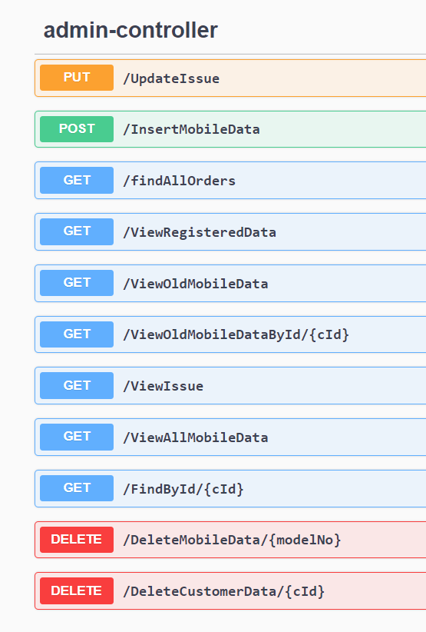
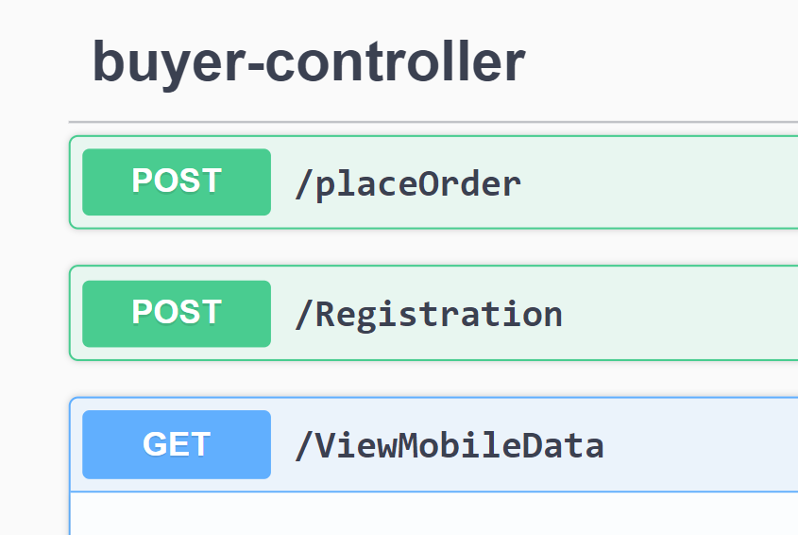
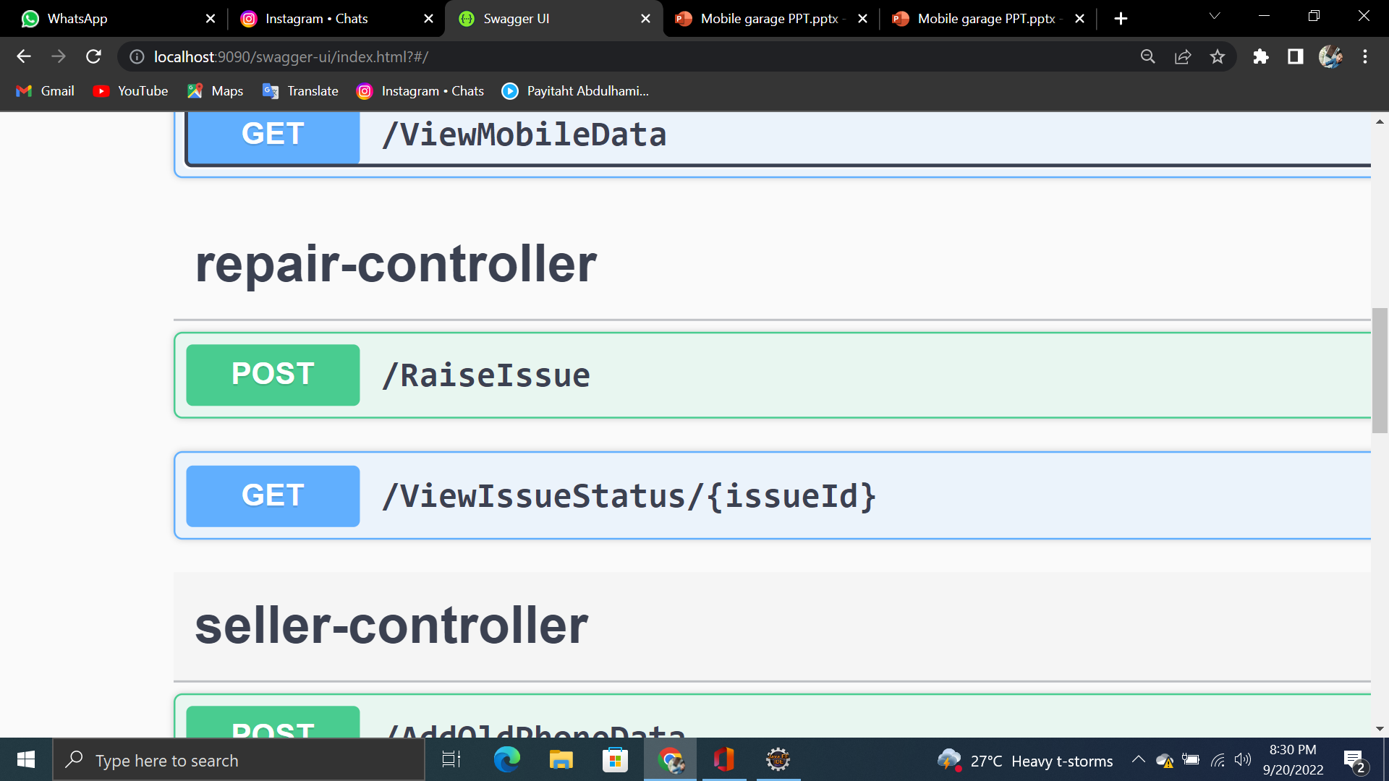
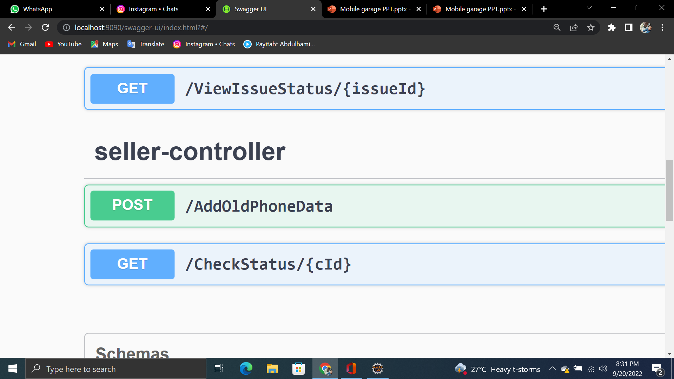
Module
ADMIN MODULE
BUYER MODULE
SELLER MODULE
REPAIR MODULE

Slide 6

Layered Architecture
Layered architecture patterns are n-tiered patterns where the components are organized in horizontal layers. This is the traditional method for designing most software and is meant to be self-independent. This means that all the components are interconnected but do not depend on each other. . There are four layers in this architecture where each layer has a connection between modularity and component within them. From top to bottom, they are
The presentation layers
The business layers
The persistence layers
The database layers

Slide 7
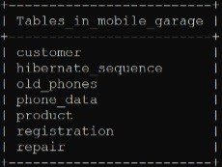
Table
mobile_garage
customer
old_phone
phone_data
product
registration
repair

Slide 8
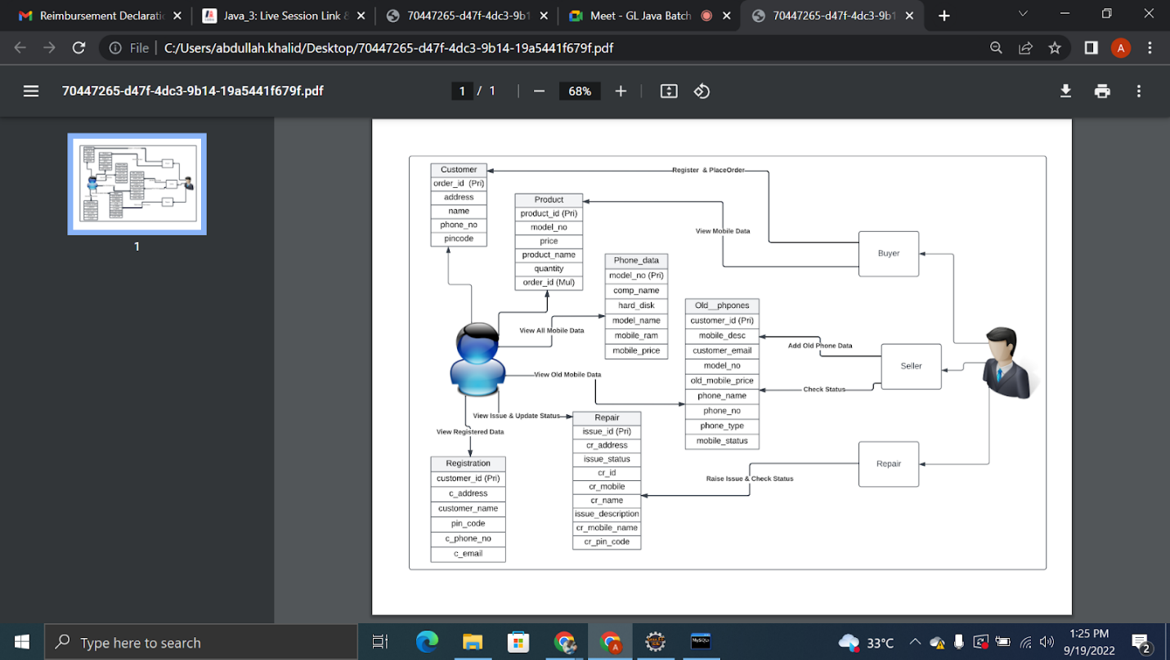
Chart (DFD)

Slide 9
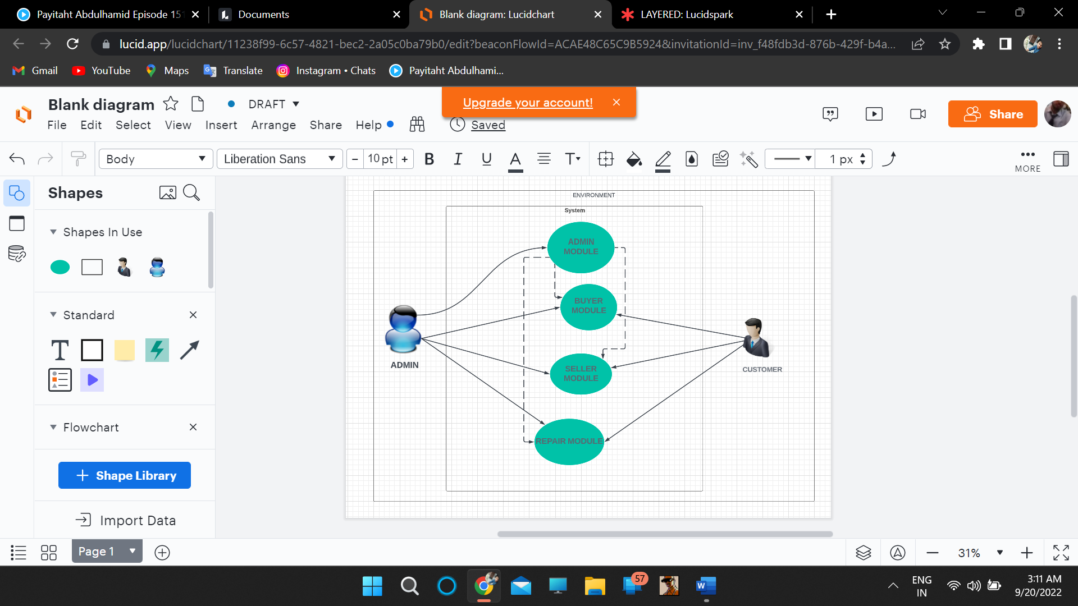
Chart (Use Case)

Slide 10





Tools & Technology
IDE : Eclipse
Language : JAVA
Framework : Spring Boot
DATABASE : MYSQL
API Documentation : SWAGGER

Slide 11

Thank You
By: STRIKER’S
{
UTTAM MEWADA
UJJWAL SRIVASTAVA
ATISHAY JAIN
JUHI KUMARI
ABDULLAH KHALID
}

